Slide 1
Towards Practical Oblivious Join
[Chang Xie Wang Li 22]
Michael Farber Brodsky

Slide 2
Preliminaries
Oblivious RAM: A cryptographic object which can obfuscate memory access patterns with a small client memory requirement, and large memory which could be monitored: accessing encrypted data remotely while hiding access patterns.
Memory access with “blocks” indexed by a position. Store and load operations are indistinguishable.
ORAM is used as a black-box but Path-ORAM is specifically mentioned due to good performance and simplicity.

Slide 3
Motivation: Memory access patterns
Consider a normal database which is stored on an encrypted disk.
The disk is evil! It records all the addresses we are accessing.
It could probably find:
Which records are important and frequently used.
Which records are relevant for the current query.
The whole structure of the B-tree, based on the way it is traversed.
Can potentially lead to understanding the order of records by each key.
Although the data in the records isn’t revealed, this is a lot of information…

Slide 4
Problem definition
A way to use large public cloud storage without revealing anything about the data being handled in the database.
Specifically, this paper presents several algorithms for oblivious joins on such a database.
An oblivious join algorithm ensures that for databases of the same size and schema and joins over them with the same input/output size, the memory access traces have the same length and can’t be distinguished by anyone but the client.

Slide 5
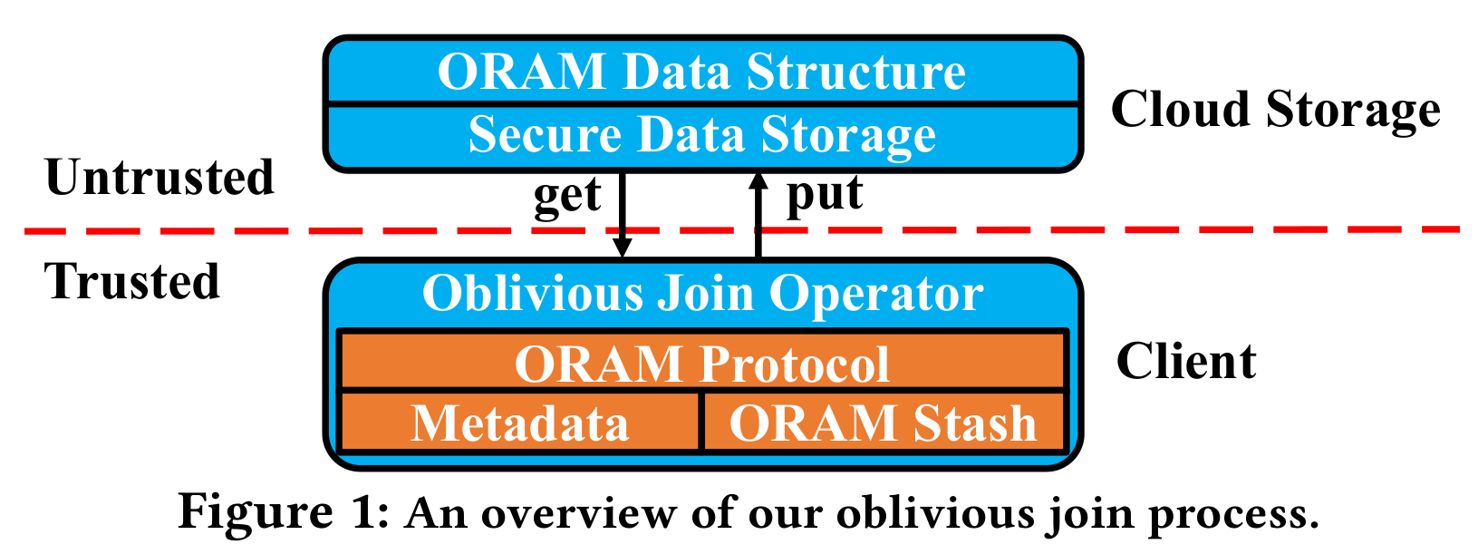
Problem definition

Slide 6
Contributions
This paper solves:
Binary equi-join
With two algorithms
Binary band join
Operators like >, >=, <, <= over the shared key
Acyclic multiway equi-join
We’ll see what Acyclic means later

Slide 7

Problem definition
Security model: an “honest-but-curious” server.
That means that the server will always act like an honest server, but might observe our memory access patterns as well as the data.
This is a useful security model because if the server gives malicious responses to a client which does store the database, the server provider would probably lose its reputation…

Slide 8
Database indexing
In a normal database we usually have a B-tree index.
We can do the same under oblivious RAM: the client stores the block ID of the root, and each node stores the block IDs of its children.
The cost of this can be reduced if we separate each table’s data and index into separate ORAMs. Furthermore, we could even use a separate ORAM for each level of a B-tree index.
Another approach is to integrate the B-tree information directly into the ORAM. When querying a node, we acquire the children simultaneously.

Slide 9
Oblivious binary join
The paper presents two join implementations: sort-merge join and index nested-loop join.
These oblivious binary join implementations can’t be used for many-to-many join because that can leak information (the join degree).
The invariant kept for the implementation is that the two tables are accessed alternately, and then exactly one tuple is written, which may be a real or a dummy record.
Finally, the dummy records are obliviously filtered out of the output table.

Slide 10
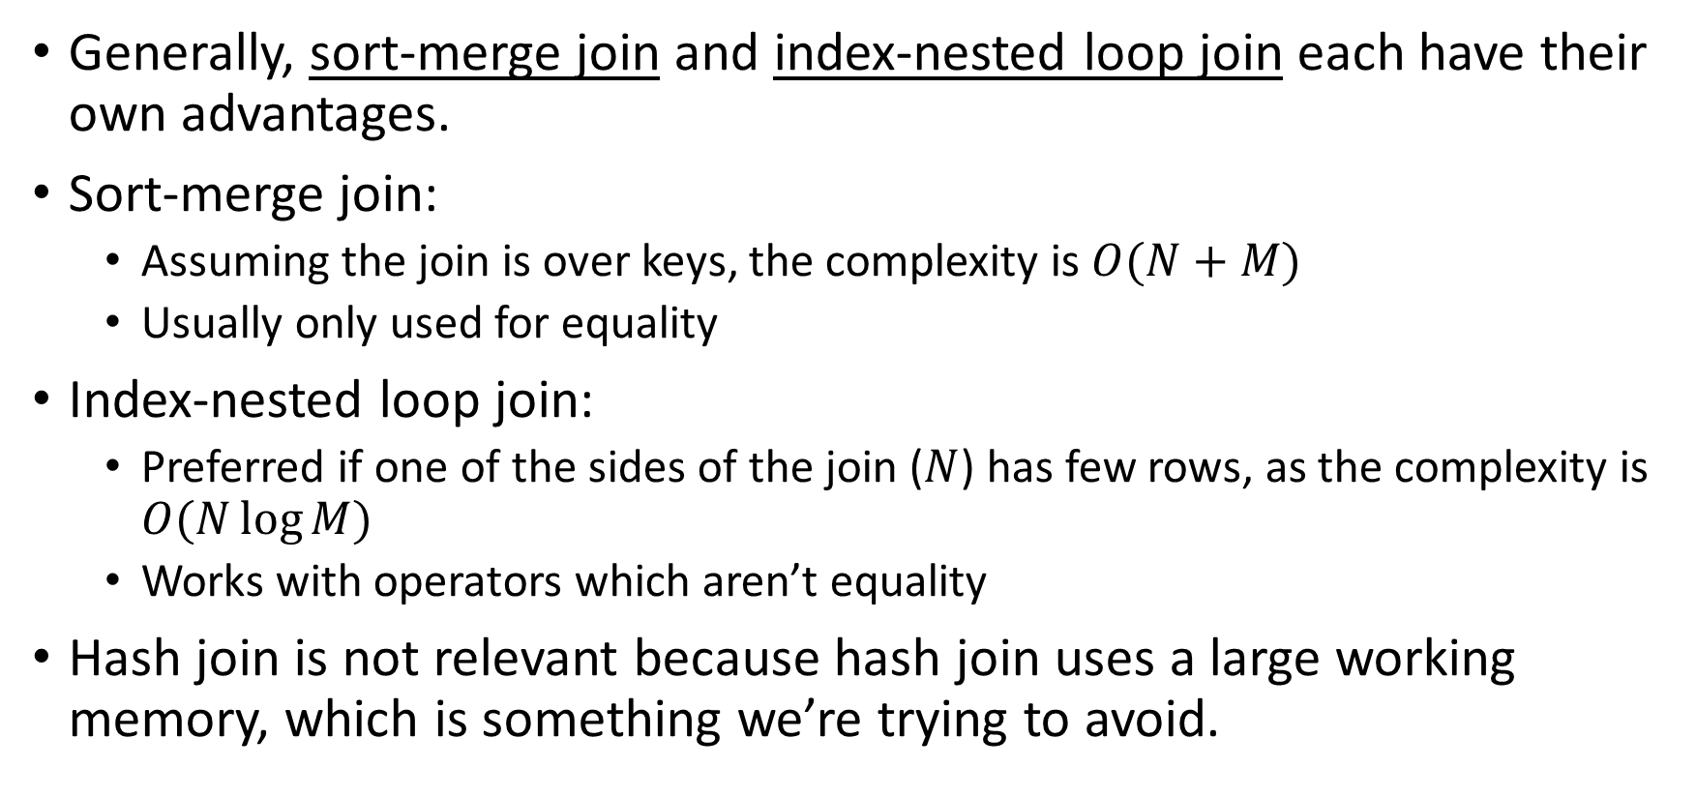
Why two algorithms
Generally, sort-merge join and index-nested loop join each have their own advantages.
Sort-merge join:
Assuming the join is over keys, the complexity is $O(N+M)$
Usually only used for equality
Index-nested loop join:
Preferred if one of the sides of the join ($N$) has few rows, as the complexity is $O(N\log{M})$
Works with operators which aren’t equality
Hash join is not relevant because hash join uses a large working memory, which is something we’re trying to avoid.

Slide 11
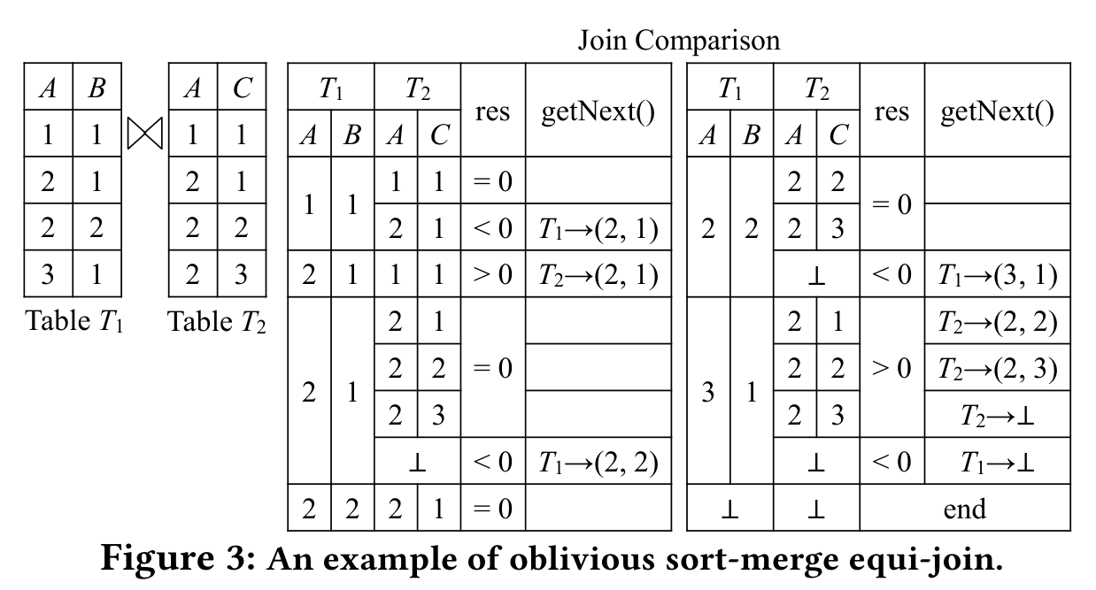
A-to-A comparison
Reached end

Slide 12
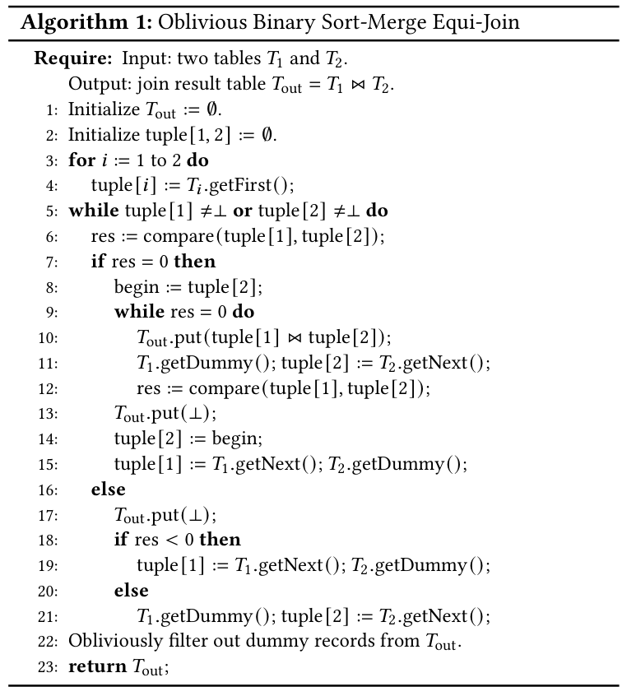
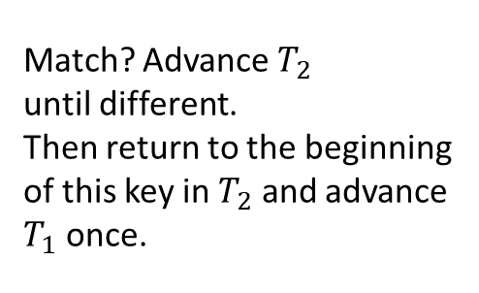
The algorithm (let’s not get too deep into it)
Match? Advance $T_{2}$
until different.
Then return to the beginning of this key in $T_{2}$ and advance $T_{1}$ once.
No match? Keep advancing whichever one is smaller, until we find a match.

Slide 13
What this algorithm achieves
Remember the definition:
An oblivious join algorithm ensures that for databases of the same size and schema and joins over them with the same input/output size, the memory access traces have the same length and can’t be distinguished by anyone but the client.
This algorithm does NOT hide the size of the join – basically, if the join result is larger because a key is repeated more times, it’s not hidden.
An adversary which can insert could be able to find the number of appearances of a key from the change in the amount of memory accesses.
Otherwise, the number of accesses, as well as the accessed tables if they’re in separate ORAMs, is determined by the join’s size.
This can be mitigated with padding (extra accesses): e.g. to next power of 2

Slide 14
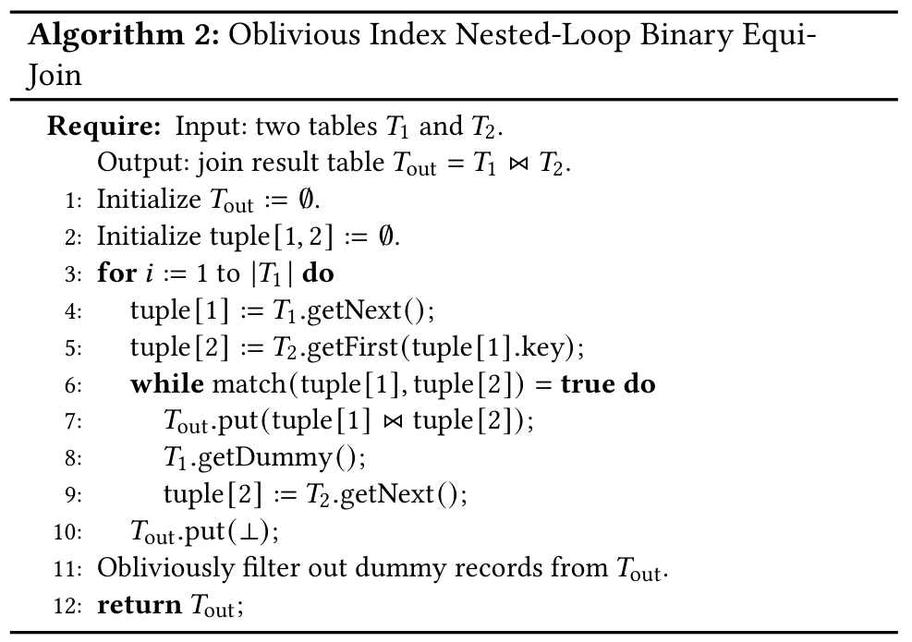
Oblivious index nested-loop binary equi-join
Similarly, the two tables are accessed alternatively, and dummy records are used. Other than that, normal index nested-loop join.
This can be extended for band-join (e.g. >, >=, <, <=), retrieving tuples until they don’t match

Slide 15
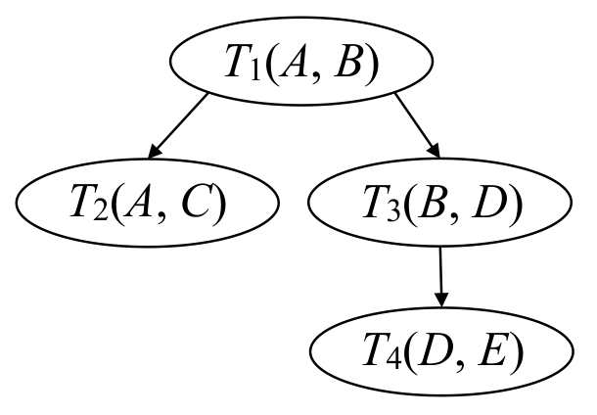


Oblivious acyclic multiway equi-join
By extending a binary equi-join algorithm to multiple tables (one join at a time into intermediate tables) we leak the intermediate table sizes – which is more information than just the join size.
The proposed join algorithm is an extension of the index nested-loop binary equi-join, and supports acyclic multi-way equi-joins.
The algorithm iterates over $T_{1}$ and searches matched tuples in $T_{2}$ and $T_{3}$.
Like previous oblivious join algorithms, it accesses each input table in round-robin.
Additionally, the number of join steps is padded to an upper bound for obliviousness.
The join result size
Notes:
Acyclicity – each table has a single parent table

Slide 16
Oblivious acyclic multiway equi-join
The acyclicity becomes interesting to make this join more efficient, by using to the following observations:
For any non-root table, if there is no match – then the parent’s current key makes no contribution to the final join result, and can be safely disabled in the B-tree. This disabling is marked on leaves and can propagate up to the B-tree parents.
This can propagate upwards to the parent table.
In equi-joins if the current tuple matches, but the succeeding tuple has a different key, there will be no more matches for the parent key. This can be marked in the B-tree leaves.
The join result size

Slide 17

Oblivious acyclic multiway equi-join
Theorem: In that way, we can achieve the following bound for the number of steps (each step accesses the ORAM in all tables):
$$\left|T_{1}\right|+2\sum_{j=2}^{ℓ}{\left|T_{j}\right|}+\left|R_{real}\right|$$
The join result size
General idea: If a tuple is enabled after being processed at least once, it will be enabled all the time. And after each tuple retrieval from each table, we will output exactly one (real or dummy) join record.

Slide 18
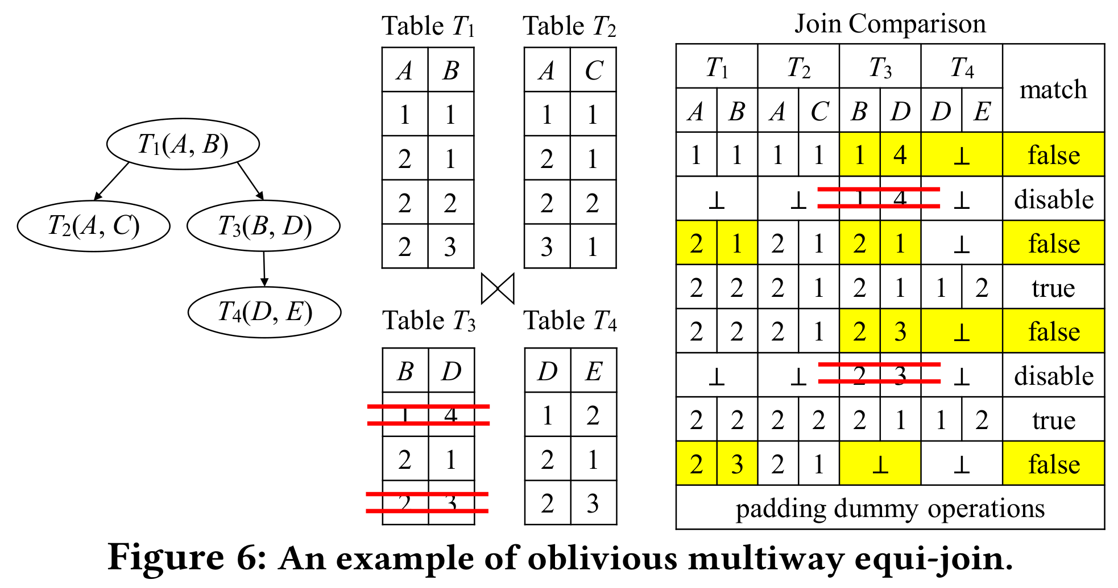

Slide 19
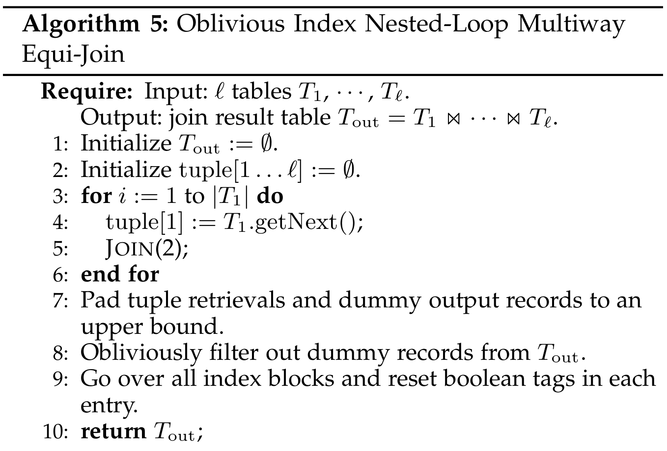
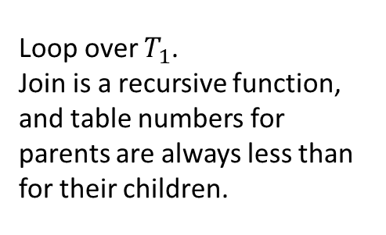
Algorithm overview
Loop over $T_{1}$.
Join is a recursive function, and table numbers for parents are always less than for their children.

Slide 20
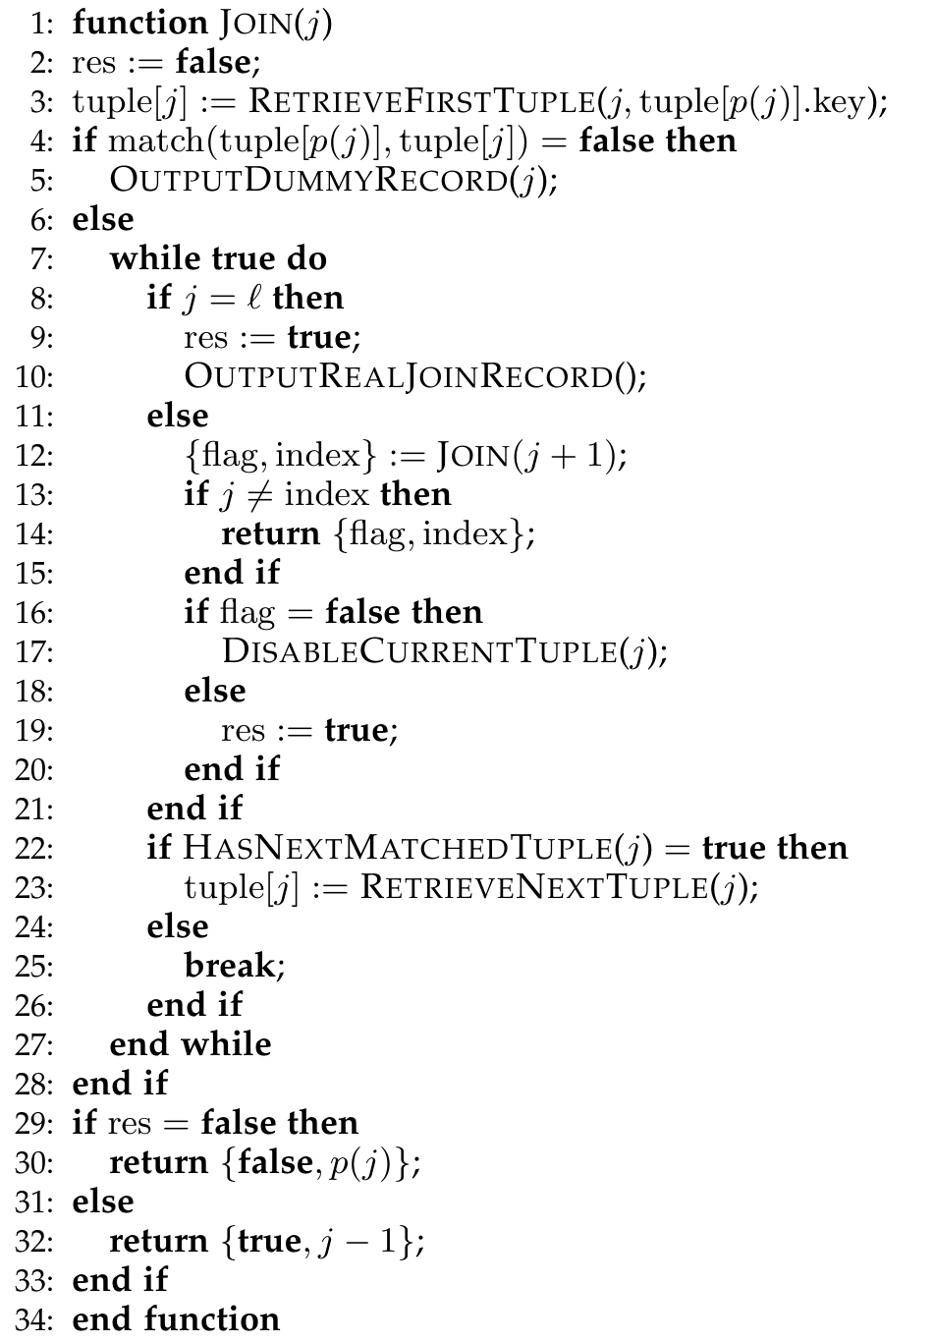
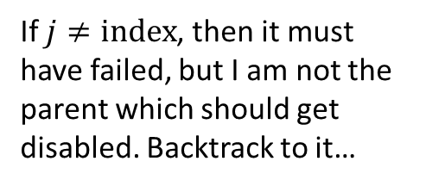
If there’s no match for the parent’s value, fail
If $j≠index$, then it must have failed, but I am not the parent which should get disabled. Backtrack to it…
If I am the target, disable me
Loop while there’s more tuples matching the parent
Return a flag – if it is false, the parent should disable its tuple

Slide 21
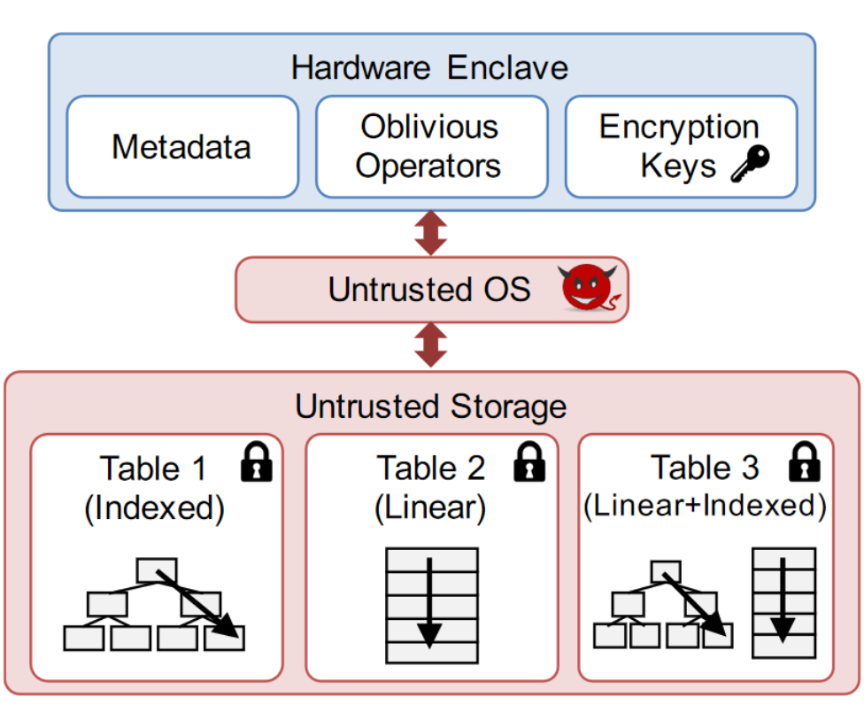
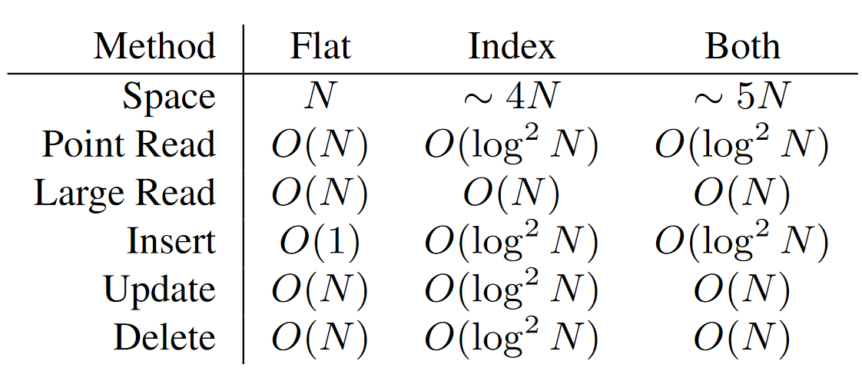
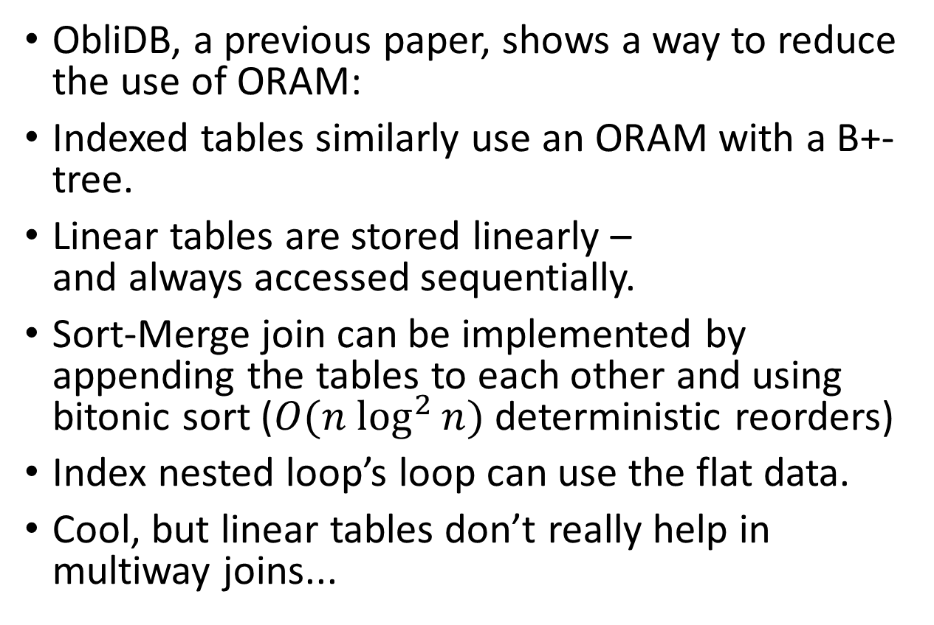
Non-ORAM approaches
ObliDB, a previous paper, shows a way to reduce the use of ORAM:
Indexed tables similarly use an ORAM with a B+-tree.
Linear tables are stored linearly – and always accessed sequentially.
Sort-Merge join can be implemented by appending the tables to each other and using bitonic sort ($O(n \log^{2}{n})$ deterministic reorders)
Index nested loop’s loop can use the flat data.
Cool, but linear tables don’t really help in multiway joins...

Slide 22
Experimental results
Client: 18GB ram, 8-core i7
Server: 256GB ram, 2TB disk, 8-core Xeon E5
Communication: 1Gb bandwidth
ORAM storage backend: MongoDB server running insertion, deletion and updates, but no other computation or optimizations.
4kb blocks
All implementations are running in non-padded mode:
The best padding is the Cartesian Product padding which doesn’t reveal the join size at all.
Another option is the closest power of 2 which means up to 2x overhead.

Slide 23
Experimental results
The compared implementations are:
Separate ORAM and One ORAM
SMJ (Sort Merge Join)
INLJ (Index Nested Loop Join)
INLJ+Cache (with Index Caching): the client caches all index blocks above the leaf level, and due to the large fan-out in the B-tree this is a small amount of storage.
Baseline: Raw SMJ, INLJ, and INLJ+Cache
Don’t use any encryption or ORAM protocol but the data is in a remote server.
Previous work:
ObliDB, ODBJ

Slide 24
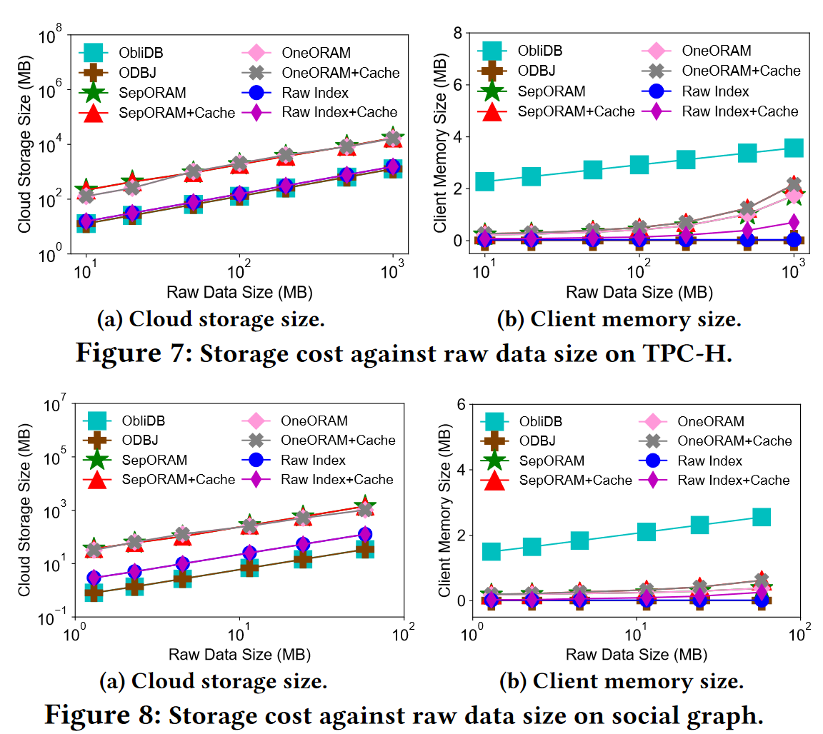
Storage and Memory
The client memory requirement is small, and not very large even with the cache.
The cloud storage size has noticeable (roughly 10X) overhead over a raw index, due to the use of Path-ORAM.

Slide 25
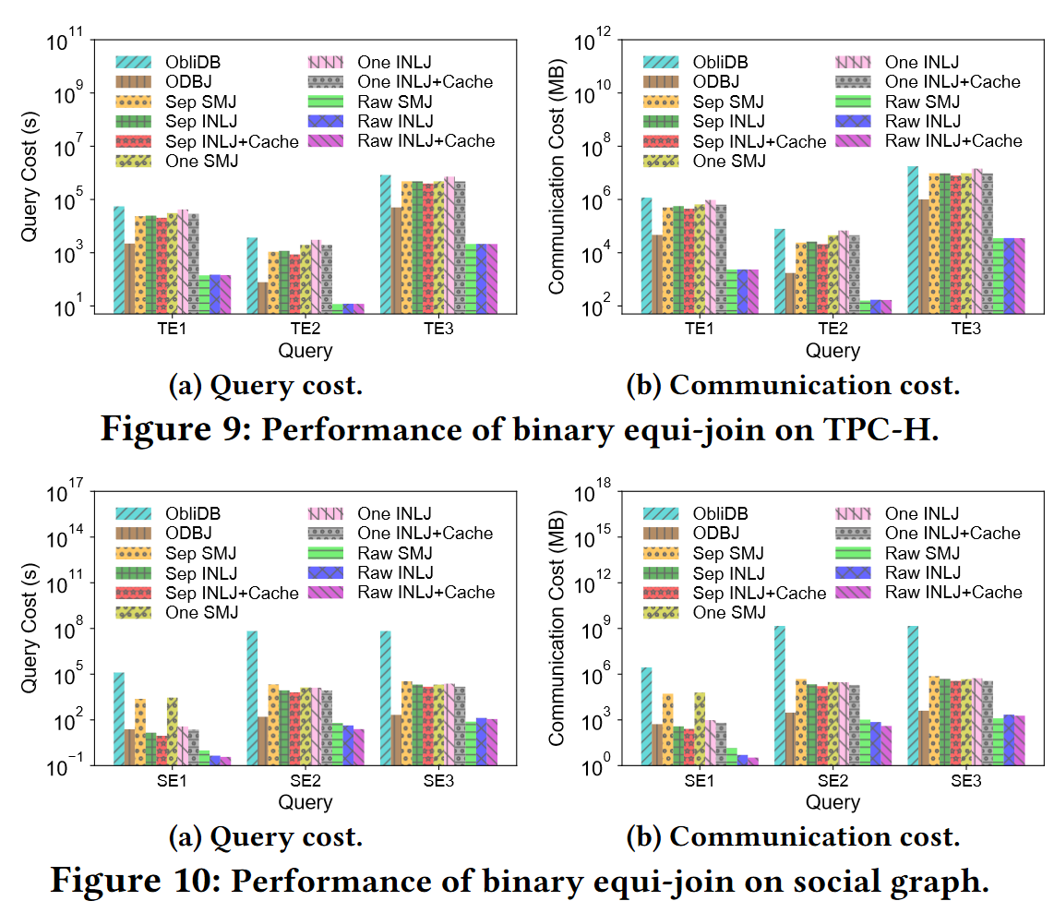
Binary Equi-Join: Performance
Sep-INLJ is 1.2-2.6X faster than One-INLJ
SepORAM(+Cache) is 90-450X more expensive than Raw Index(+Cache) except for SE1.
However, the data tuples are only 100-200 bytes in TPC-H and 2 integers in social graph, and the block size of the ORAM is 4KB.

Slide 26
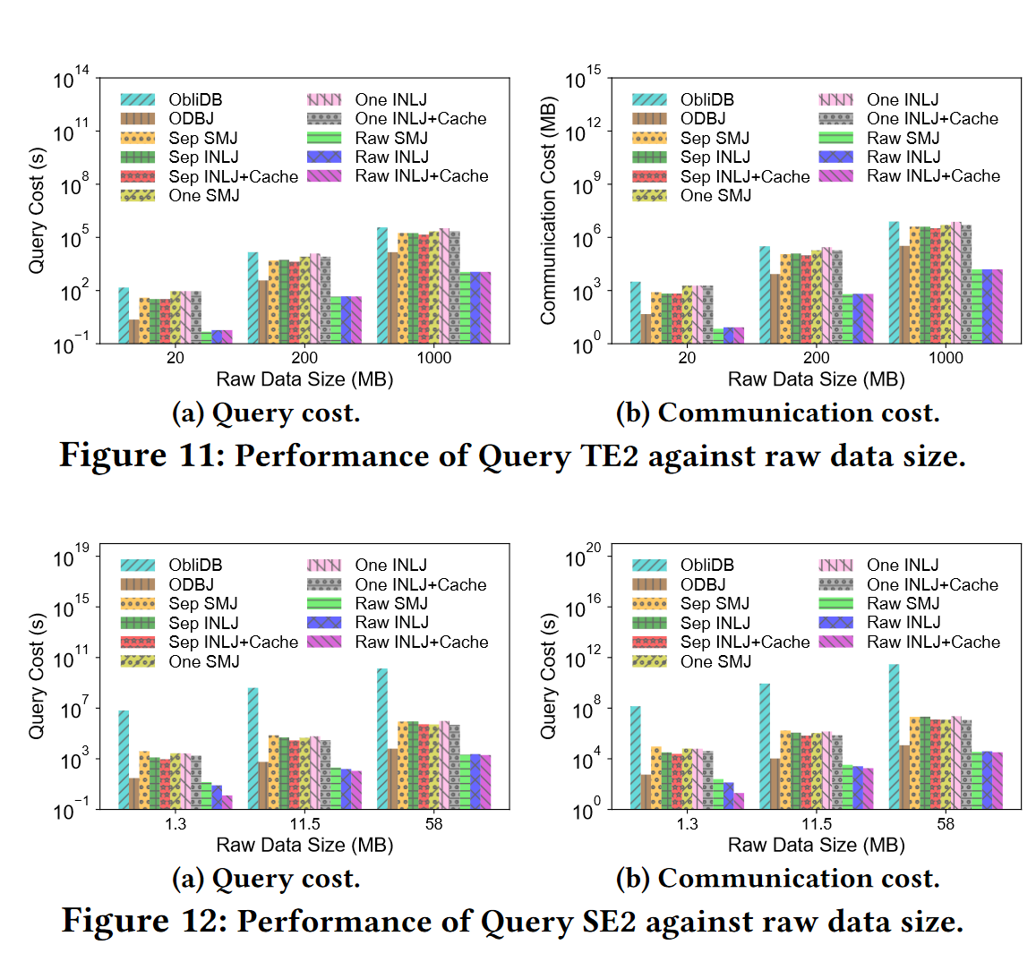
Binary Equi-Join: Scalability
The performance difference is again because of the block size.
The merge algorithm is scalable.

Slide 27
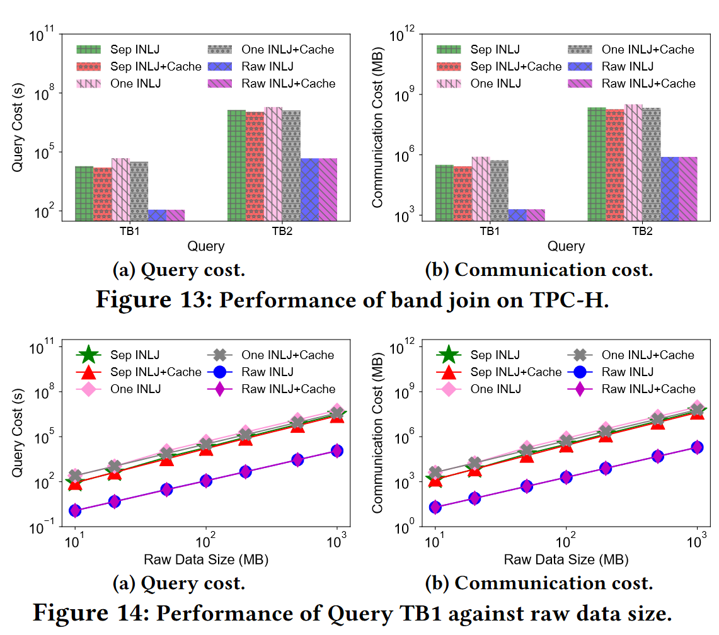
Binary Band Join: Performance
TB1 (10MB)
Sep is 164-238X slower than Raw.
Sep is 1.4-2.5X faster than One.
Caching is 1.2-1.5X faster.
TB2 (1GB):
Sep is 73-264X slower than Raw.
Sep is 1.9-2.9X faster than One.
Caching is again 1.2-1.5X faster.

Slide 28
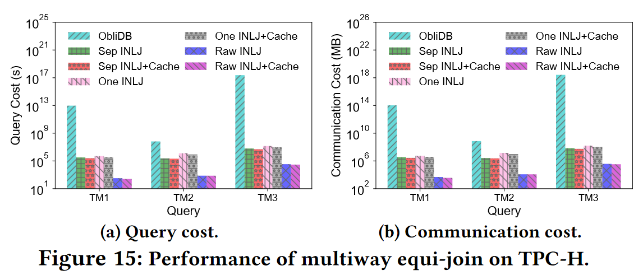
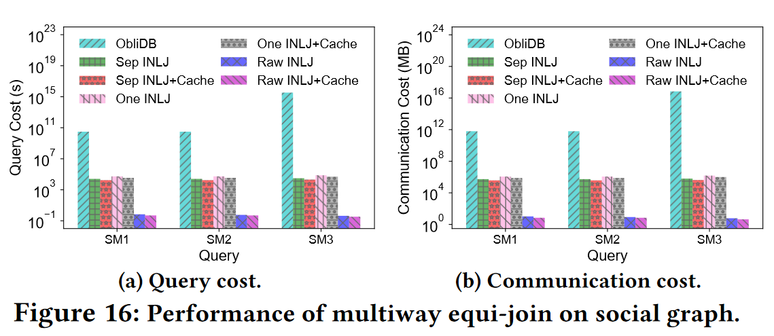
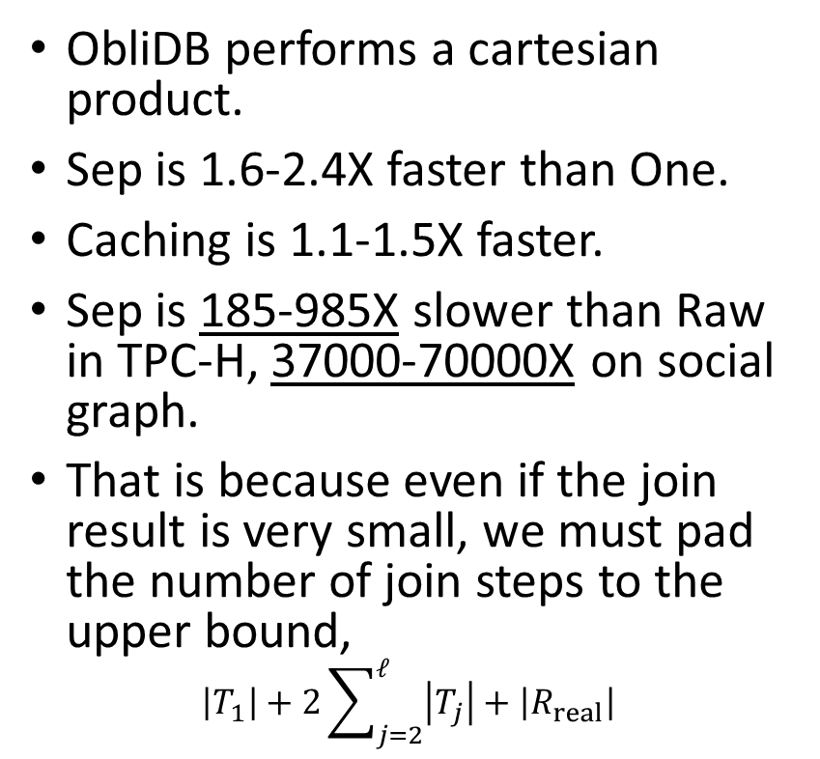
Multiway Equi-Join: Performance
ObliDB performs a cartesian product.
Sep is 1.6-2.4X faster than One.
Caching is 1.1-1.5X faster.
Sep is 185-985X slower than Raw in TPC-H, 37000-70000X on social graph.
That is because even if the join result is very small, we must pad the number of join steps to the upper bound,
$$\left|T_{1}\right|+2\sum_{j=2}^{ℓ}{\left|T_{j}\right|}+\left|R_{real}\right|$$

Slide 29
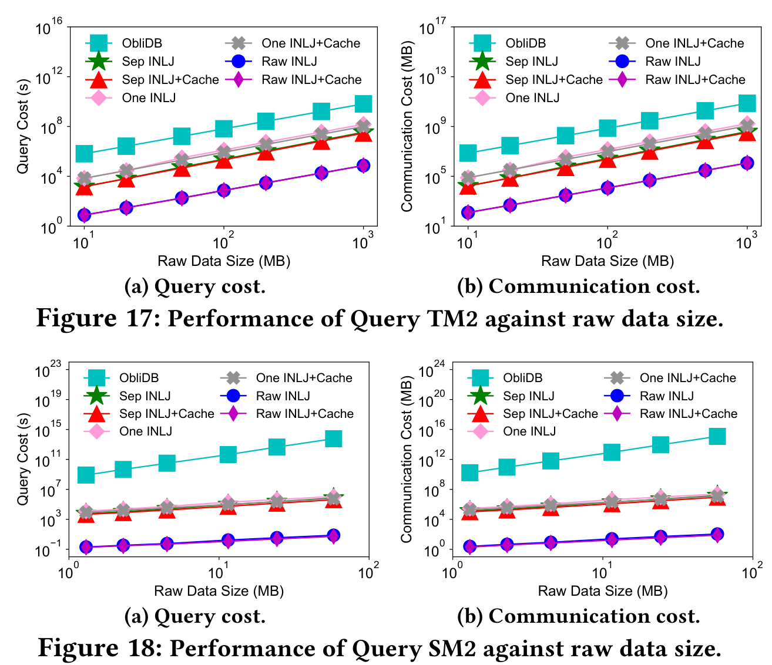
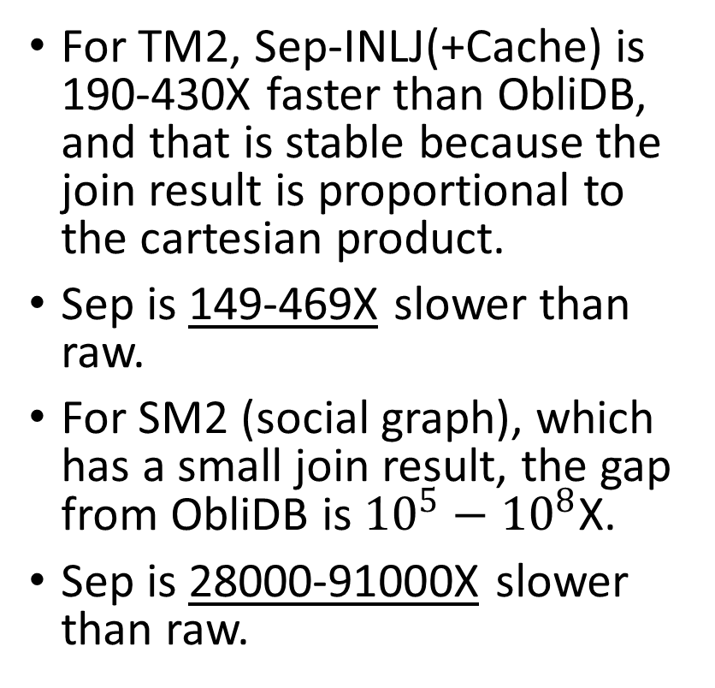
Multiway Equi-Join: Scalability
For TM2, Sep-INLJ(+Cache) is 190-430X faster than ObliDB, and that is stable because the join result is proportional to the cartesian product.
Sep is 149-469X slower than raw.
For SM2 (social graph), which has a small join result, the gap from ObliDB is ${10}^{5}−{10}^{8}$X.
Sep is 28000-91000X slower than raw.

Slide 30
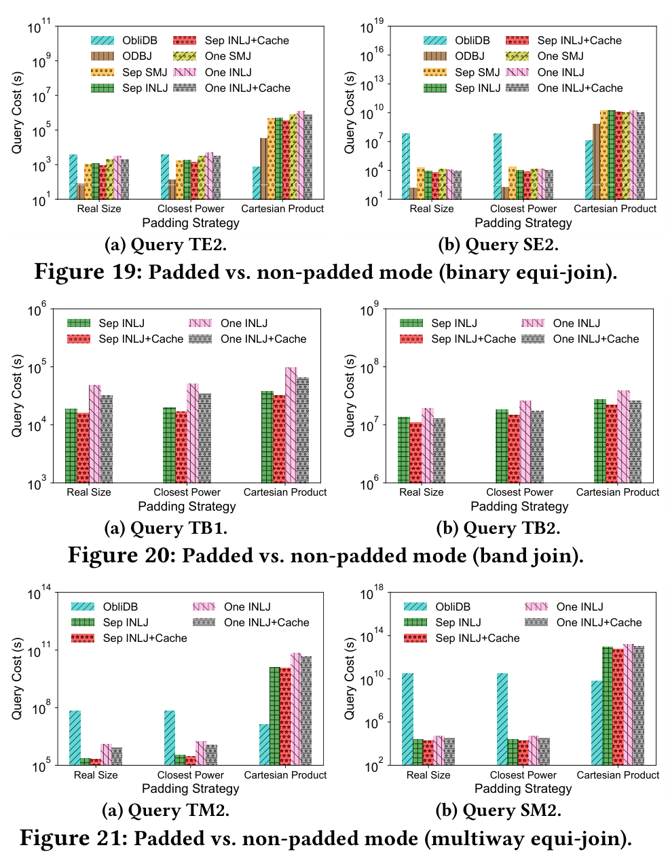
Padding Performance
Closest power is (obviously) within 2X of Real Size.
ObliDB is faster with Cartesian Product than it is with Real Size or Closest Product because otherwise it uses oblivious filtering.
ObliDB is best at Cartesian Product because we have less trusted memory and use B-tree searches over ORAMs (instead of a linear database).

Slide 31
Conclusions
We have explored some of the most foundational join algorithms in a new light.
Oblivious RAM is cool and it’s a thing! In fact, the Signal messenger uses it for contact discovery, along with a secure enclave.
We can learn a lot from memory access patterns. As an example, that kind of information could be leaked by a cache attack.
Oblivious RAM is a nice and useful abstraction but when using it we are still responsible to make the number of accesses deterministic.
Even by timing how long the server takes to respond, we could measure how many join results there are, which is an interesting attack vector.

